Slide 1
Week 1 (1) – Orientation and Course Overview
CST370 (Spring A, 2020)
Design & Analysis of Algorithms
Feiling Jia

Slide 2
Agenda
Welcome and introduction
Course introduction
Practice puzzles

Slide 3


Education
Self Introduction
BS and MS, Computer Science
Fudan University
Shanghai, China
(MS degree: 1986)
PhD, Computer Science
University of California, Davis
(PhD degree: 1993)

Slide 4


Professional Background
Networking/telecom service providers (Pacific Bell, SBC, AT&T), currently at AT&T Labs (San Ramon, California)
Networking start-ups: product management, architecture
Part-time teaching at SJSU (in-class)
  Networking, algorithms, operating systems
Part-time teaching at CSUMB (online):
  CST370 (2017 Spring A, 2018 Spring A, 2019 Spring A)

Slide 5
Instructor
Feiling Jia, Ph.D.
Email: fjia@csumb.edu
Phone: 925-998-9861
Zoom
  https://csumb.zoom.us/j/4457737239
Office hours
  Tuesday: 6:30pm – 7:30pm (through zoom)
  Thursday: 6:30pm – 7:30pm (through zoom)

Slide 6
TA
Name: Isaac Torres
Email: istorres@csumb.edu
Zoom:
  https://csumb.zoom.us/j/2677482974
Office Hours: Monday (6:10pm - 8:10pm), Tuesday (12:00pm - 2:00pm)

Slide 7
Now your turn

Slide 8
Course Information
Course number and title
  CST 370: Design and Analysis of Algorithms
Credits: 4.0
Prerequisites
  CST 238 or instructor's consent
Refer to Course Syllabus for details
  https://docs.google.com/document/d/1Ox_tS2UP5knXRSLKSQl2h9kWsnl-d3P9IRP5124tB7A/edit?usp=sharing

Slide 9
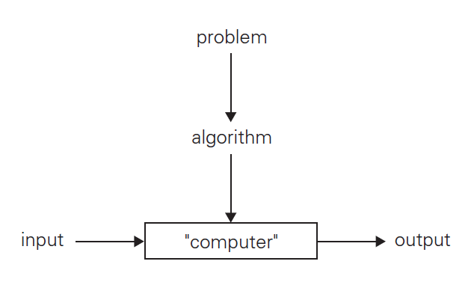
What is Algorithm
An algorithm is a sequence of unambiguous instructions for solving a problem, i.e., for obtaining a required output for any legitimate input in a finite amount of time.

Slide 10
Motivations for Algorithms
Algorithm is the core of the core of Computer Science
  No computer programs without algorithms
Algorithms are often the secret sauces :
  might be controlling self-driving cars, executing massive amount of stock trades, detecting the dog breed in a picture, etc.
Algorithm questions in many interviews

Slide 11
Google Recruiter Email
The following list is a part of an email from a google recruiter regarding their interview questions.
  As you can see, many problems are about algorithms.
  Algorithm Complexity: You need to know Big-O. If you have difficulty analyzing the basic Big O complexity, you will rarely be hired.
  Sort: You should know how to sort.
  Hashtables: Probably the single most important single data structure known to mankind. ...
  Tree: ...
  Graph: ...
  Other data structures: As many different data structures and algorithms as possible should be studied.
  …

Slide 12
Main Objectives
Acquire algorithm design techniques
  Brute force
  Divide-and-conquer
  Greedy method
  etc.
Learn important data structures
  Heap, tree, graph, etc.
Analyze efficiency of algorithms
Notes:
80X86 means

Slide 13
Main Topics
Review of fundamental data structures
Analysis of algorithm efficiency
Brute-force algorithm design technique
Divide-and-conquer
Decrease-and-conquer
Transform-and-conquer
Space and time tradeoffs
Graph algorithms
Dynamic programming
Greedy method
Advanced topics, if time permitted

Slide 14
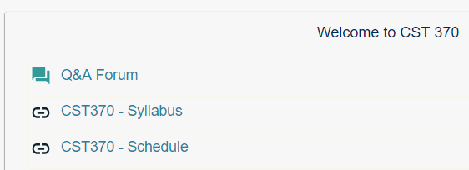
Course Web Site
http://iLearn.csumb.edu/
  Additional course information and announcements will be posted here.
  If you have something to announce or share with all students, post it in the “Q&A Forum”.
Notes:
Tour of web site!

Slide 15
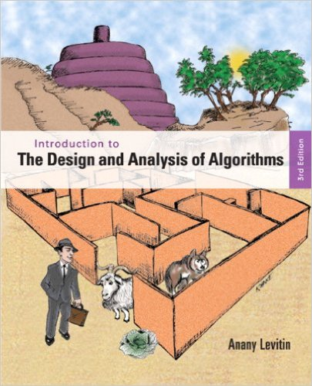
Required Textbook
Author: Anany Levitin
Title: Introduction to the Design and Analysis of Algorithms, 3rd Edition
Publisher: Addison Wesley, 2011
ISBN-13: 978-0-13-300136-5
  (This is eTextBook. But a paper book is also fine.)

Slide 16
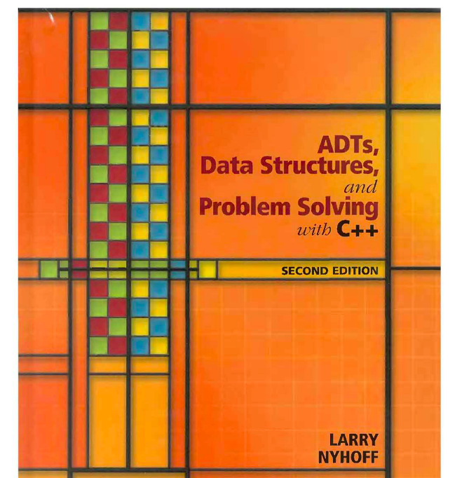
Reference Book (Optional)
Author: Larry Nyhoff
Title: ADTs, Data Structures, and Problem Solving with C++, 2nd Edition
Publisher: Prentice-Hall, 2005
ISBN: 0-13-140909-3

Slide 17
Class ID Number
To process the homework and exam more efficiently, we require you to choose your 4-digit class ID number (such as 7694, etc.)
  The number can be a four-digit integer number.
  If there are duplicated numbers chosen by two students, I will ask a student to choose a different number.
Send an email to me (fjia@csumb.edu) with your class ID number

Slide 18
Exams
First midterm:
  Jan 25 (Saturday) from 10:00(AM) to 12:30(PM)
Second midterm:
  Feb 15 (Saturday) from 10:00(AM) to 12:30(PM)
Final:
  Feb 29 (Saturday) from 10:00(AM) to 12:30(PM)
Mark your calendar.
Details will be given later.

Slide 19
Homework
Problem solving and programming project assignments will be given throughout the semester.
No late submission will be accepted.
Refer to the homework 1 on the iLearn as an example.

Slide 20
Homework Programming
For the programming assignment, you have to use the C++ programming language
IDE
  You may use your own favorite IDE
  Examples: CodeBlock (Windows), Visual Studio (Windows), Xcode (Mac), etc.

Slide 21
Grading Policy
Midterm-I | 15%
Midterm-II | 15%
Final Exam | 15%
Homework | 55%
Grade
A | 100 | 90 ≥
A- | 90 < | 87 ≥
B+ | 87 < | 84 ≥
B | 84 < | 80 ≥
B- | 80 < | 77 ≥
C+ | 77 < | 73 ≥
C | 73 < | 67 ≥
D | 67 < | 57 ≥
F | 57 < | 0
Note that D and F are a not passing grade.

Slide 22
Overall Course Schedule
Refer to the course schedule on the iLearn.

Slide 23
Note to Students with Disabilities
Students with disabilities who may need accommodations
  Please see me as soon as possible during the office hour or make an appointment
Also, contact:
  Student_Disability_Resources@csumb.edu
  Building 47, Student Services, First Floor
  Phone: 831/582-3672 voice, or 582-4024 fax/TTY
  http://csumb.edu/sdr

Slide 24
Academic Integrity Policy
All graded assignments (e.g. exam, quiz, and homework) must be conducted individually.
Cheating of any kind will not be tolerated.
  Two or more students submitting extremely similar code will receive a zero on the assignment. Furthermore, they will be reported to the academic dishonesty board.
https://csumb.edu/policy/academic-integrity-policy

Slide 25
Weekly Study Guide
Each Week there are a set of power points files as “Study Guide”
Follow the Study Guide
  There will be several videos and Google docs in the file.
  If there’s a “<<< Course Instruction >>>” or “Exercise” in the file, follow the instruction on the slide.

Slide 26
Example: <<< Course Instruction >>>
Before proceeding to the next slide, read from the page 1 through the page 7 of our textbook.
  Even if you don't understand some parts of the textbook, read it first.
  After that, go to the next slide.

Slide 27
“Exercise” Example
Calculate the gcd (40, 56) using the Euclid’s algorithm.
  // Do not move directly to the next slide.
  // First, solve this problem yourself.
  // Then, compare your answer with the solution
  // on the next slide.

Slide 28
Algorithmic Puzzle
In the course, we will talk about a few algorithmic puzzles that are interesting problems related to algorithms.
  They are important parts of our lectures.
Sometimes, we may discuss a puzzle that is not directly related to the algorithm we cover.
  However, the puzzle is frequently mentioned at a technical job interview.

Slide 29
Puzzle: Angle of Two Clock Hands
We know that the angle of the two clock hands is 90 degrees at 3:00(PM).
  Then what is the angle of the two clock hands when the time is 3:15 (PM)?

Slide 30
Important Note
Do not see the answer immediately on the next page.
Hint
  When the long clock needle moves, the shorter one also moves. But it moves more slowly.
  Recall that one hour is 60 minutes.

Slide 31
Puzzle: River Crossing Puzzle
There are four people who want to cross a bridge. You have 17 minutes to get them all across to the other side.
  It is night, and they have one flashlight.
  A maximum of two people can cross the bridge at one time. Any party that crosses must have the flashlight with them.
  Person A takes 1 minute to cross the bridge, person B takes 2 minutes, person C takes 5 minutes, and person D takes 10 minutes.
  A pair must walk together at the rate of the slower person’s pace. For example, if person A and person D walk across together, it will take 10 minutes to get to the other side of the bridge.

Slide 32
Important Note
When you solve a puzzle or an exercise in the lecture, do not look immediately at the answer on the following page.
  If you do, you will not get any knowledge from the puzzle (and exercise as well).
  Always try to solve it before checking the answer at the next slide.
  And also, use paper and pencil when you solve it.

Slide 33
Solution

Slide 34
Things to Do
Review syllabus and course schedule
Get the textbook
Install C++ IDE (if applicable)
Brush up your C++ skills and run sample C++ programs
Study the next lecture (week_1_2.ppt) on the iLearn
Complete Homework #1
  Don't forget that the due of homework 1 is Jan 8 (Wed) (11:55 PM).

Slide 35
<<< Course Instruction >>>
This is the end of orientation.
  Please let me know if there is anything you don't understand in the orientation.

